Slide 1

INTERNSHIP PROJECT REPORT
PROJECT TITLE
“Optimizing Employee Retention and Performance Through Data-Driven HR Strategies”
TEAM MEMBERS:
Mansi Nitin Bamgude
C. Ramanathan
B. Jacinth Jones
Internship Position: Data Analyst Intern Date: 19 AUGUST 2024

Slide 2
TABLE OF CONTENTS
Executive Summary
Introduction
Company Overview
Project Description
Project Objective(s)
Methodology
Work Undertaken
Tools & Technologies Used
Data analysis and findings
Implementation
Key Learnings
Conclusion

Slide 3
OBJECTIVE OF THE FINAL PROJECT
This report provides an overview of the internship project titled "Optimizing Employee Retention and Performance Through Data-Driven HR Strategies" carried out at Intervie Tech. The project aimed to analyse employee data to identify key factors affecting retention and performance. Using data-driven approaches, the project sought to develop strategies to enhance employee satisfaction and reduce turnover. The outcomes included actionable insights that could be used to inform HR policies and improve overall organizational effectiveness.
Project Objectives:
The project focused on several key objectives:
Data Analysis: To analyse historical employee data, including demographics, performance metrics, and exit interviews, to identify patterns and trends related to employee retention and performance.
Predictive Modelling: To build and validate predictive models that forecast employee turnover and identify employees at risk of leaving, allowing for proactive interventions.
Strategy Development: To develop actionable, data-driven recommendations for HR policies and practices aimed at improving employee engagement, satisfaction, and retention.

Slide 4
REQUIREMENTS AND INSTALLATIONS
Python: Ensure you have Python installed on your system.
IDE: Jupyter Notebook or Visual Studio Code
Libraries: The following Python libraries are required:
Pandas
NumPy
re (Regular Expressions, part of the standard library)
Matplotlib
Seaborn
Scikit-Learn

Slide 5
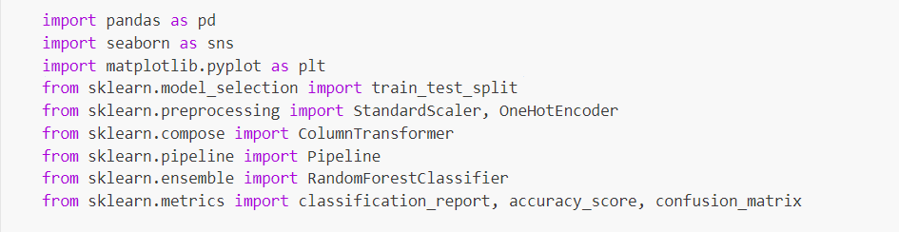
IMPORT LIBRARY

Slide 6
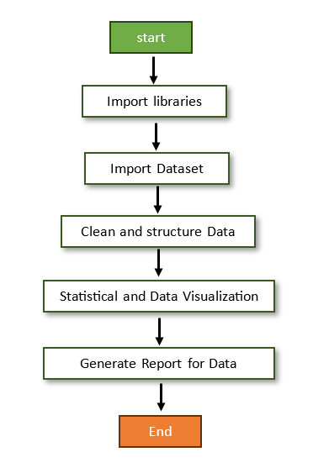
WORKING FLOWCHART

Slide 7

METHODOLOGY
Data Collection
Data Cleaning & Preparation
Exploratory Data Analysis (EDA)
Predictive Modelling
Insights & Visualization

Slide 8
IMPORT DATASET:

Slide 9
DATA ANALYSIS & FINDINGS
1. Data Exploration
The dataset was initially explored to understand its structure and content:
First Few Records: The dataset included various columns related to employee demographics, job roles, performance metrics, and attrition status.
Data Information: Provided insights into data types, non-null counts, and overall data distribution.
Descriptive Statistics: Summary statistics were used to understand the central tendency and dispersion of numerical features.

Slide 10
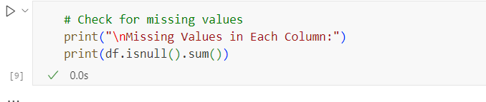
2. Data Cleaning
Missing Values: Identified and addressed any missing values in the dataset to ensure accurate analysis.
Categorical Encoding: Categorical variables were encoded to numerical values using Label Encoding for the target variable (Attrition), and one-hot encoding was applied to other categorical features.

Slide 11
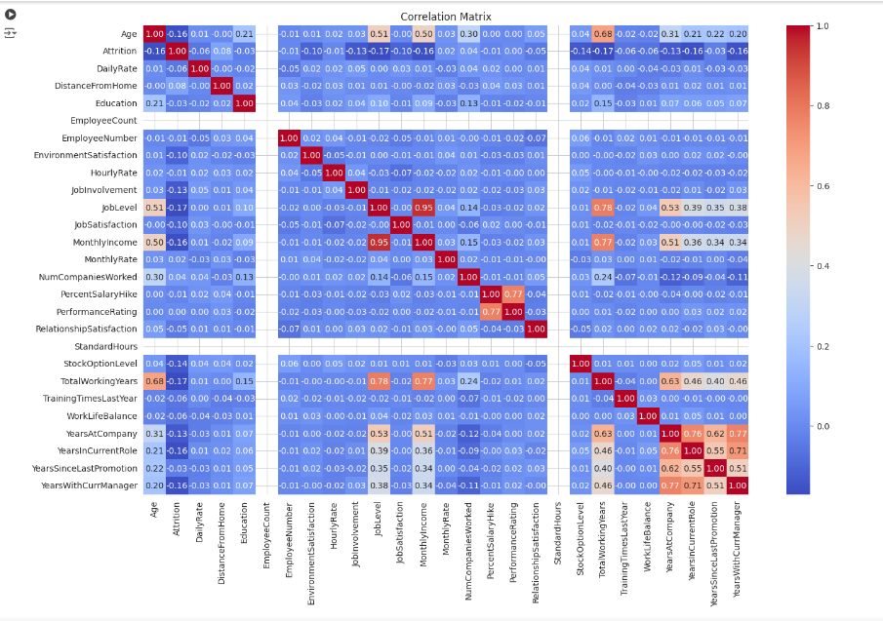
3. Exploratory Data Analysis (EDA)
Correlation Matrix:
Visualized the correlation between numerical features using a heatmap.
Key observations included significant correlations between job satisfaction, monthly income, and employee turnover.

Slide 12
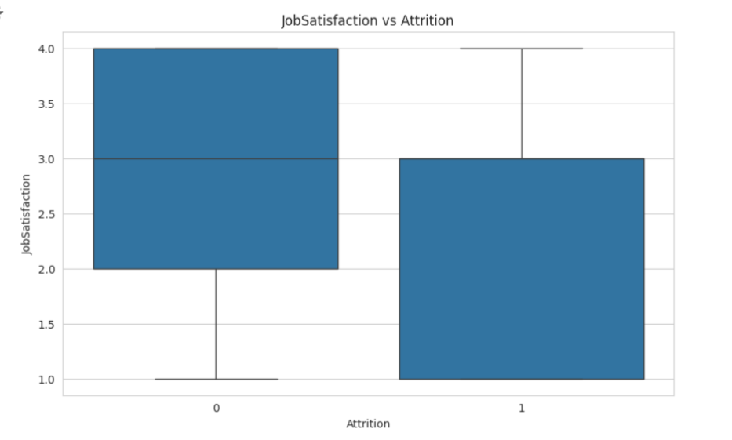
3. Exploratory Data Analysis (EDA)
Boxplots:
Boxplots were used to visualize the distribution of important features (Job Satisfaction, Monthly Income, Age, Years At Company, Total Working Years, Over Time) against attrition status.

Slide 13
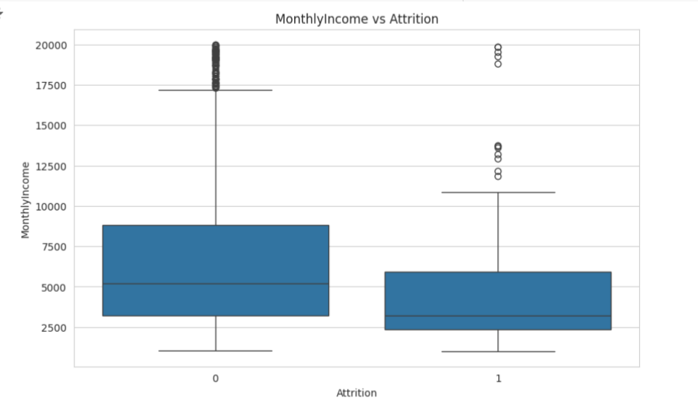
3. Exploratory Data Analysis (EDA)
Boxplots:
Boxplots were used to visualize the distribution of important features (Job Satisfaction, Monthly Income, Age, Years At Company, Total Working Years, Over Time) against attrition status.

Slide 14
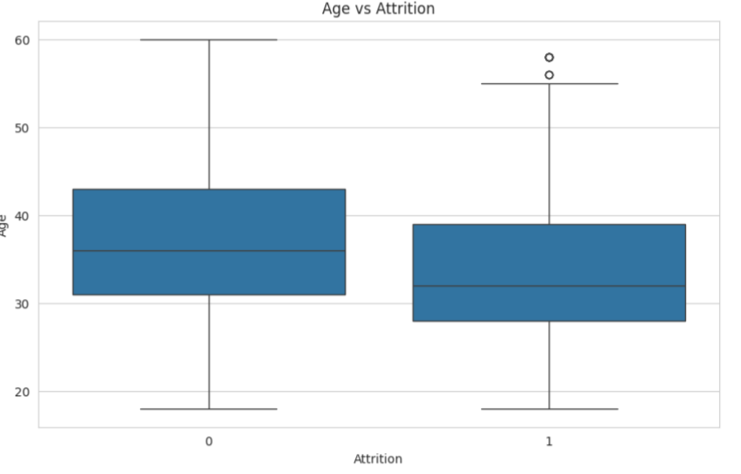
3. Exploratory Data Analysis (EDA)
Boxplots:
Boxplots were used to visualize the distribution of important features (Job Satisfaction, Monthly Income, Age, Years At Company, Total Working Years, Over Time) against attrition status.

Slide 15
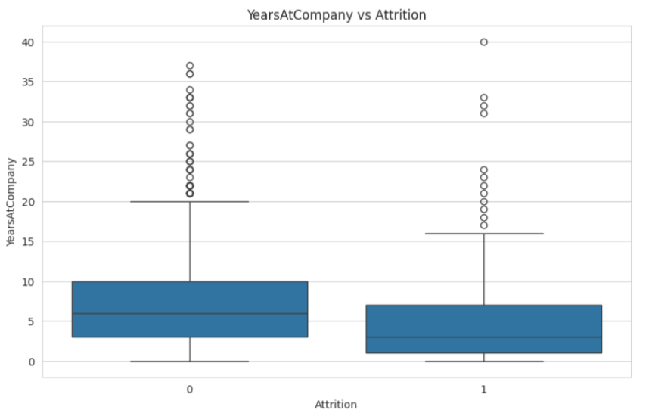
3. Exploratory Data Analysis (EDA)
Boxplots:
Boxplots were used to visualize the distribution of important features (Job Satisfaction, Monthly Income, Age, Years At Company, Total Working Years, Over Time) against attrition status.

Slide 16
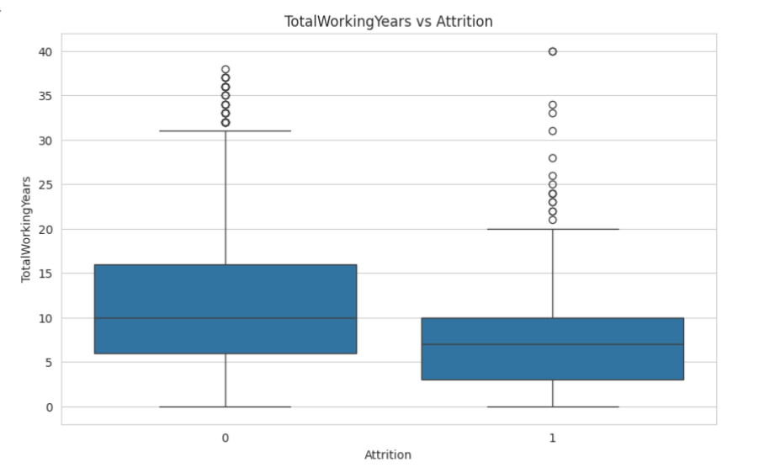
3. Exploratory Data Analysis (EDA)
Boxplots:
Boxplots were used to visualize the distribution of important features (Job Satisfaction, Monthly Income, Age, Years At Company, Total Working Years, Over Time) against attrition status.

Slide 17
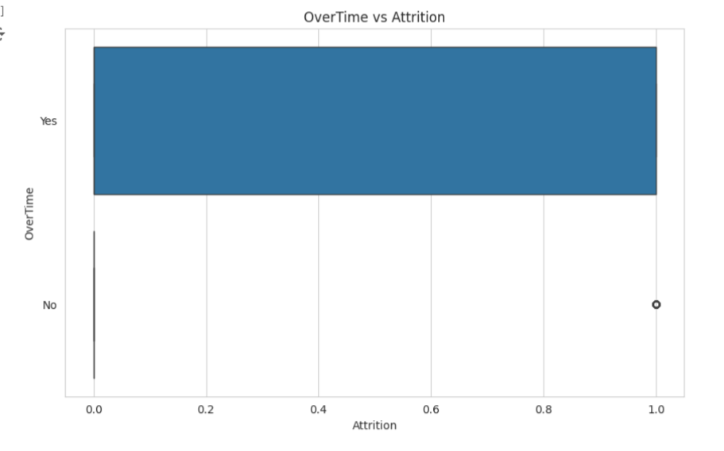
3. Exploratory Data Analysis (EDA)
Boxplots:
Boxplots were used to visualize the distribution of important features (Job Satisfaction, Monthly Income, Age, Years At Company, Total Working Years, Over Time) against attrition status.

Slide 18
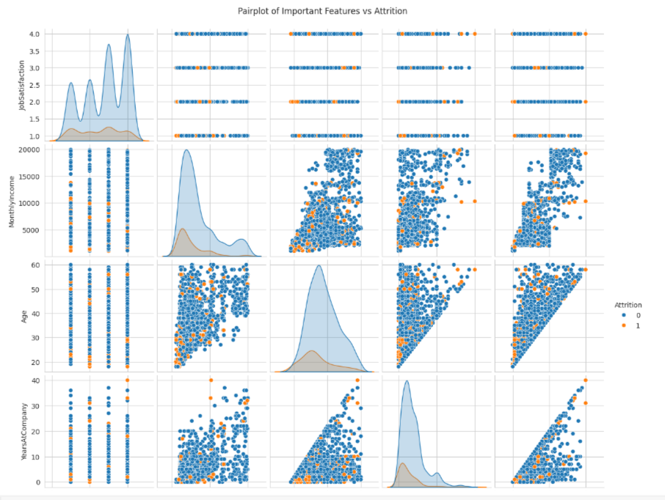
3. Exploratory Data Analysis (EDA)
Pair plot:
Provided a visual representation of the relationships between selected numerical features and attrition status.
Revealed patterns where features like job satisfaction and income were closely associated with employee retention.

Slide 19
4. Predictive Modelling
Feature Selection:
Recursive Feature Elimination (RFE) was used to identify the most important features for predicting attrition.
The selected features included Job Satisfaction, Monthly Income, Age, Years At Company, Total Working Years, and Over Time.
Model Training:
A Random Forest Classifier model was trained using the selected features.
Model Performance:
Confusion Matrix: Showed the true positives, false positives, true negatives, and false negatives for attrition predictions.
Classification Report: Provided precision, recall, f1-score, and support for both classes (Attrition and No Attrition).
Accuracy: Indicated the overall effectiveness of the model in predicting employee turnover.

Slide 20
5. Feature Importance
Importance Scores:
The Random Forest Classifier model provided feature importance scores, highlighting the relative importance of each feature in predicting attrition.
Key features with high importance included Job Satisfaction, Monthly Income, and Over Time.
Feature Importance Visualization:
A bar plot of feature importance scores illustrated the significance of each feature.
Features such as Job Satisfaction and Monthly Income were identified as critical factors influencing employee attrition.

Slide 21
6. Insights & Recommendations
Key Insights:
Employees with lower job satisfaction and lower monthly income are at higher risk of attrition.
The length of service and overall satisfaction are strong predictors of whether an employee will leave.
Recommendations:
Enhance Job Satisfaction: Implement initiatives to improve job satisfaction, such as career development programs and regular feedback.
Review Compensation: Reassess compensation packages to ensure they are competitive and fair.
Improve Work-Life Balance: Address factors affecting work-life balance to retain employees longer.
Focus on Career Development: Offer career growth opportunities to employees to increase their tenure and performance.

Slide 22
KEY LEARNINGS
Technical Skills
Data Cleaning and Manipulation: Gained proficiency in using Python for cleaning and preprocessing large datasets, handling missing values, and encoding categorical variables effectively.
Predictive Modelling and Machine Learning: Developed skills in applying machine learning algorithms, such as Random Forest Classifier, for predictive modelling. Gained experience in feature selection techniques and model evaluation.
Data Visualization: Enhanced ability to create insightful visualizations using libraries like Seaborn and Matplotlib. Created dashboards and plots that effectively communicated trends and patterns in the data.

Slide 23
KEY LEARINGS
Professional Skills
Communication: Learned to translate complex technical findings into actionable insights for non-technical stakeholders. Developed skills in creating clear and concise reports and presentations.
Project Management: Improved project management abilities by managing a large dataset and conducting comprehensive analysis within a defined timeline. Gained experience in prioritizing tasks and delivering results efficiently.
Personal Growth
Understanding Data-Driven Solutions: Developed a deeper understanding of how data analysis can be applied to solve real-world business challenges, particularly in optimizing employee retention and performance.
Confidence and Independence: Gained confidence in working independently on complex projects and presenting findings to senior management. Strengthened skills in taking ownership of tasks and driving project outcomes.

Slide 24
CONCLUSIONS
The internship project provided valuable insights into the factors affecting employee retention and performance at Interview Tech. By leveraging data-driven approaches, the project identified key areas for improvement in HR practices, leading to recommendations that could enhance employee satisfaction and reduce turnover. The predictive models developed during the project offer a proactive approach to managing retention, allowing the HR team to take pre-emptive actions.

Slide 25


